Slide 1
Philippians 1:12-18
Transformed by the Gospel!
Preached by Dan Bridges Amman International Church, Jordan (AmmanChurch.org) Uploaded by Dr. Rick Griffith • Jordan Evangelical Theological Seminary Files in many languages for free download at BibleStudyDownloads.org

Slide 2
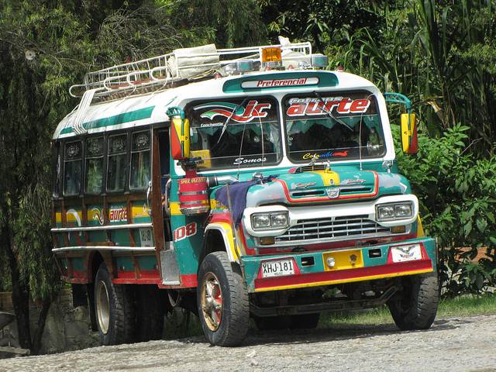
How would your theology and faith handle this?
Notes:
A number of years ago a missionary was working in a remote mountainous region. They were working on translating the Bible into a language that did not yet have a Bible. It was in the days before computers, and the entire manuscript was written by hand. After spending a number of years completing the translation, they finally finished it. They were on their way to the capital of that country to start the process of getting it printed.
They were riding in a bus similar to this one. The manuscript was in a suitcase up on top of the bus. The roads were rough and mountainous, and somewhere along the way, the suitcase containing the manuscript bounced off and was forever lost.

Slide 3
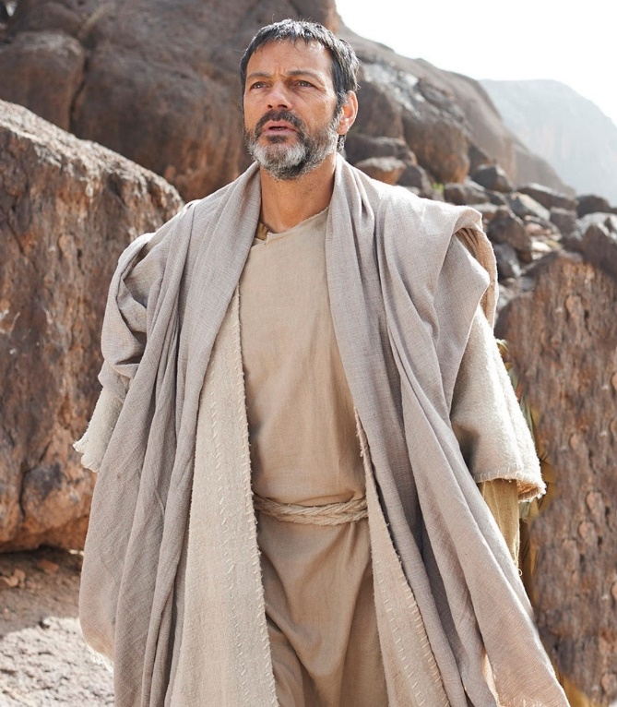
The Apostle Paul’s faith and theology were “life proof”!
A perspective on life, ministry and suffering - transformed by the gospel!
Notes:
Today and next week we get to take an inner look into Paul’s heart. We get to hear from him what his perspective was on life, ministry and suffering. God will teach us through Paul powerful truths about what a mature Christian looks like!

Slide 4
The Gospel in Philippians
God intends for the gospel to transform:
Our Identity (1-2)
Our Relationships (3-8)
Our Prayer (9-11)
How we face difficulty (12-18)
How we see the future (18-26)

Slide 5
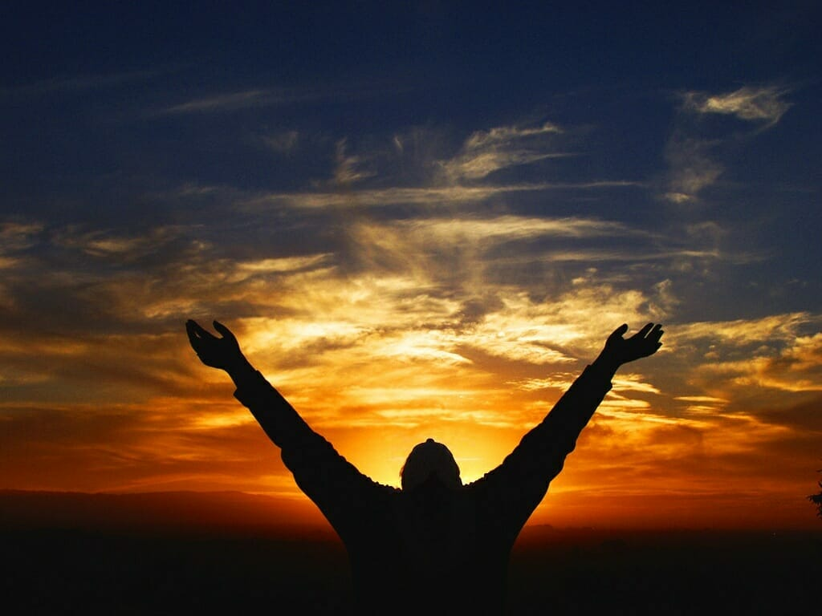
Overall Context: Paul’s Personal Update
Verses 12-18a: Paul’s current circumstances
Verses 18b-26: Paul’s perspective on his future

Slide 6
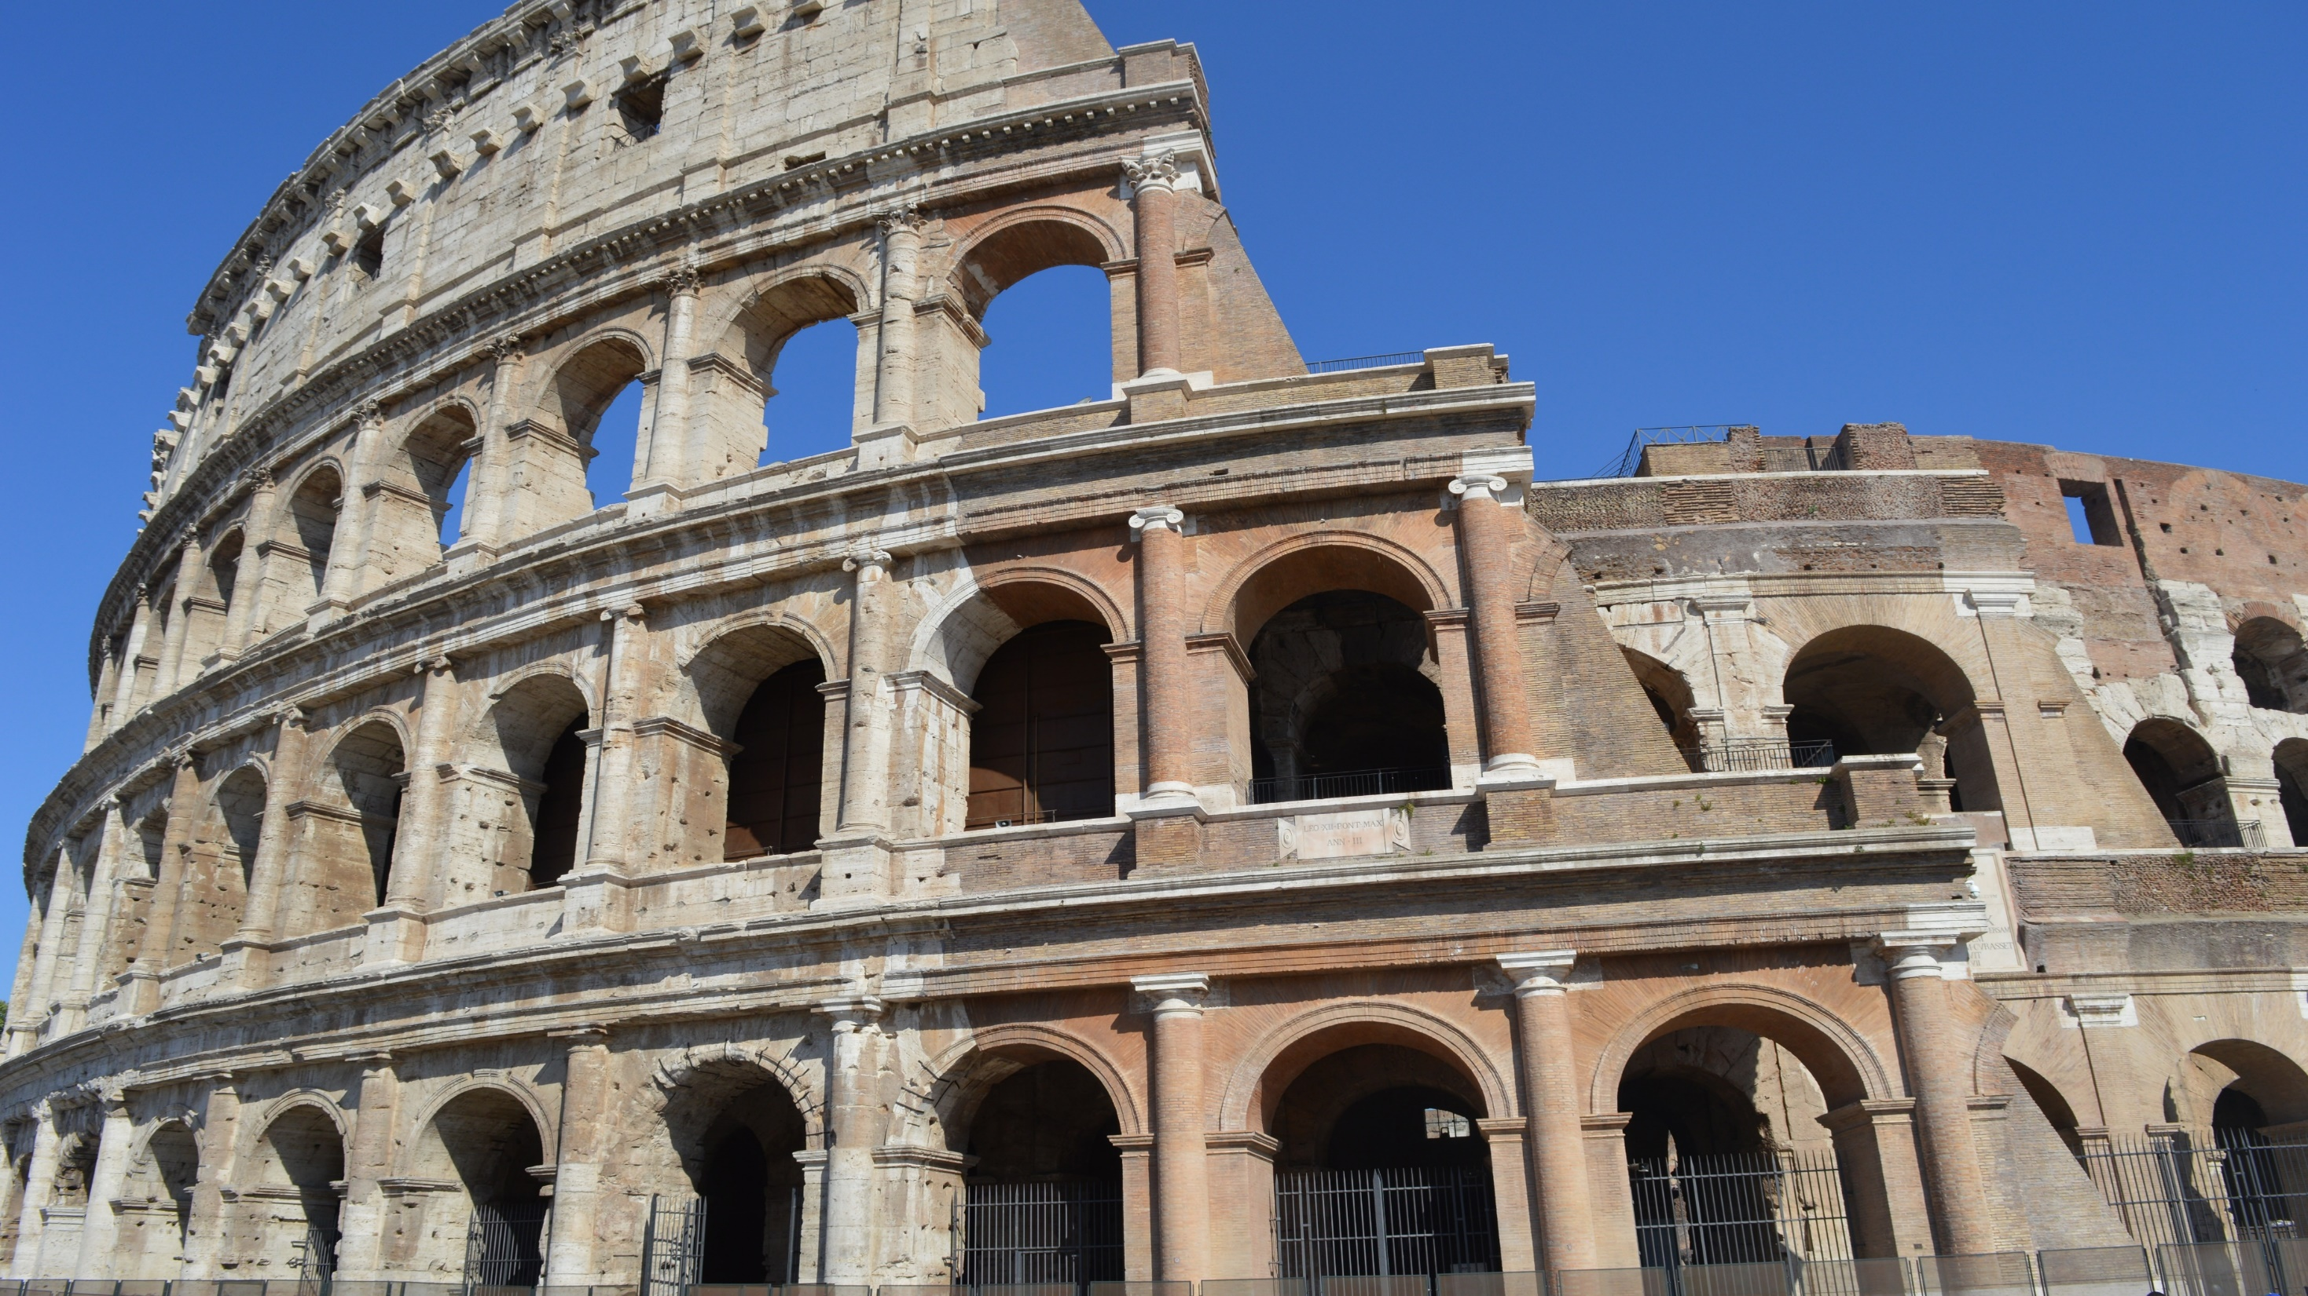
What were Paul’s current circumstances?
Paul was writing from Rome
Backstory of the church in Rome
Paul’s personal experiences

Slide 7
The Timeline…
Death/Resurrection of Jesus
Paul’s Arrest in Jerusalem
Letter to the Philippians
Roman Church Founded?
Paul’s Arrival in Rome
Philippian Church Founded
Letter to the Romans
30
50
57
61
62

Slide 8
The Church in Rome
Well-established by 57AD (letter to Romans)
Consisted of both Jews and Gentiles
Evidence of conflict between Jews & Gentiles
(2 streams separate for many years)

Slide 9
Jewish Believers in the Early Church
²⁰ … and [James and the elders] said to him, “You see, brother, how many thousands there are among the Jews of those who have believed, and they are all zealous for the Law; ²¹ and they have been told about you, that you are teaching all the Jews who are among the Gentiles to abandon Moses, telling them not to circumcise their children nor to walk according to the customs. ²² So what is to be done? They will certainly hear that you have come. Acts 21:20-22

Slide 10
What were Paul’s current circumstances?
Arrested in Jerusalem in ~57AD
Imprisoned in Caesarea for 2 years
Traveled to Rome (shipwreck!)
Imprisoned in Rome for 2+ years (Acts 28:30)

Slide 11
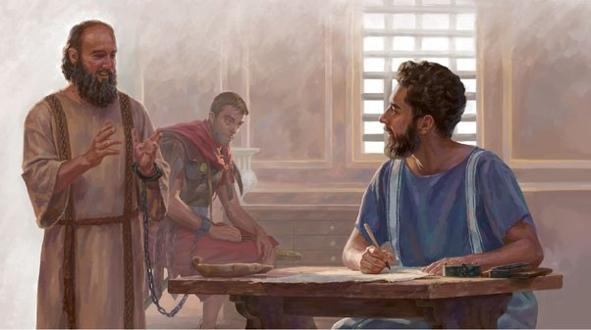
Paul’s Imprisonment…
House arrest (Acts 28:30)
He at times mentions a “coupling chain”, so was most likely chained to a guard 24/7
Guards were called “Praetorian guards”, and changed shifts every 6 hours

Slide 12
¹² I want you to know, brothers, that what has happened to me has really served to advance the gospel, ¹³ so that it has become known throughout the whole imperial guard and to all the rest that my imprisonment is for Christ. ¹⁴ And most of the brothers, having become confident in the Lord by my imprisonment, are much more bold to speak the word without fear.
Philippians 1:12-14

Slide 13
¹⁵ Some indeed preach Christ from envy and rivalry, but others from good will. ¹⁶ The latter do it out of love, knowing that I am put here for the defense of the gospel. ¹⁷ The former proclaim Christ out of selfish ambition, not sincerely but thinking to afflict me in my imprisonment. ¹⁸ What then? Only that in every way, whether in pretense or in truth, Christ is proclaimed, and in that I rejoice.
Philippians 1:15-18

Slide 14
So What does Paul Focus on in his “Update”?
¹² I want you to know, brothers, that what has happened to me has really served to advance the gospel, ¹³ so that it has become known throughout the whole imperial guard and to all the rest that my imprisonment is for Christ.
Paul explains how his circumstances are furthering the cause of the gospel!
Notes:
What had happened to Paul? He was imprisoned and chained to a Roman guard 24 hours a day
How could the gospel ever have penetrated the Praetorian guard and the household of Ceasar?
Imagine the conversations between the guards as they discussed Paul!

Slide 15
So What does Paul Focus on in his “Update”?
¹⁴ And most of the brothers, having become confident in the Lord by my imprisonment, are much more bold to speak the word without fear.
Paul explains how his circumstances are encouraging others to boldly proclaim Christ!
Notes:
Seeing that Paul was willing to be imprisoned for his faith encouraged them to have faith in the face of persecution
Seeing that Paul continued to boldly proclaim the gospel encouraged them also to be bold

Slide 16
So What does Paul Focus on in his “Update”?
¹⁵ Some indeed preach Christ from envy and rivalry, but others from good will… ¹⁷ The former proclaim Christ out of selfish ambition, not sincerely but thinking to afflict me in my imprisonment. ¹⁸ What then? Only that in every way, whether in pretense or in truth, Christ is proclaimed, and in that I rejoice.
Paul shares the freedom he feels in his heart about ministry competition… and his joy in the midst of it!
Notes:
Though we don’t know for sure who these believers were, they were most likely Jews who were proclaiming Jesus as the Messiah but insisting that converts follow the Jewish law
They were in “competition” with Paul – wanting other believers to follow the law as they did
Though their preaching may not have directly affected Paul in prison, their competitive spirit must have been difficult for him

Slide 17
How would you summarize Paul’s “personal” update…
His Joy at how the gospel was being proclaimed in Rome!
Paul’s entire perspective on life and suffering had been transformed by the gospel!
Notes:
Why?
This passage does not tell us. But in 1:21, we learn that for Paul, “For me to live is Christ” and in 3:8, we learn that for Paul, “all was considered a loss compared to the surpassing greatness of knowing Christ!”

Slide 18
What was the Gospel According to Paul?
¹² … what has happened to me has really served to advance the gospel,
¹³ so that it has become known throughout the whole imperial guard … that my imprisonment is for Christ… ¹⁵ Some indeed preach Christ from envy and rivalry… ¹⁷ The former proclaim Christ out of selfish ambition… Only that in every way, whether in pretense or in truth, Christ is proclaimed, and in that I rejoice.

Slide 19
What was the Gospel According to Paul?
The gospel is not just a message – it’s the person of Jesus! Advancing the gospel means making Jesus known!
Jesus is the only source of righteousness before God (3:8-9)
An intimate and passionate relationship with Jesus is the only thing worth living for (1:21, 3:8-9)

Slide 20
What was the Gospel According to Paul?
“What is more, I consider everything a loss compared to the surpassing greatness of knowing Christ Jesus my Lord, for whose sake I have lost all things. I consider them rubbish, that I may gain Christ, and be found in him, not having a righteousness of my own that comes from the law, but that which is through faith in Christ – the righteousness that comes from God and is by faith.” Philippians 3:8-9

Slide 21
How had the Gospel Transformed Paul?
He was truly content in difficult circumstances beyond his control
His vision and passion for God’s purposes did not fade in difficulty
He lived in expectant faith that God was at work
He lived a life of joy!

Slide 22
He was truly content in difficult circumstances beyond his control
After almost 5 years as a prisoner, there is no hint of complaint
His words are full of hope – they encouraged the Philippians!
No bitterness toward believers who want to cause problems for him
Notes:
- Stuck at home with kids, stuck in a career, stuck without a iqama, stuck without a car

Slide 23
2. His vision and passion for God’s
purposes did not fade in difficulty
Chained to a guard 24/7, he simply used that as an opportunity to share the gospel
He worked tirelessly to preach Christ to whoever he could get access to
He prayed for and wrote letters to the churches
He continued to spiritually lead a large portion of the church of his day

Slide 24
3. He lived in expectant faith that God was at work
The gospel is advancing… because all the guards know I am in prison for Christ
The gospel is advancing… because the brothers have been encouraged to speak without fear
The gospel is advancing… because Christ is being proclaimed – regardless of motive
Notes:
Our kids, our classmates, our co-workers, unbelievers around us

Slide 25
3. He lived in expectant faith that God was at work
What do you think he would have said had he been writing two years earlier – before he had seen the impact of his ministry in Rome? Was his faith just based on “results” that he saw?
“I eagerly expect that God will use my circumstances here in Rome for his glory and the advancement of his gospel!”
Notes:
Our kids, our classmates, our co-workers, unbelievers around us

Slide 26
4. He lived a life of Joy!
“Only that, in every way, whether in pretense or in truth, Christ is proclaimed, and in that I rejoice.”
“Yes, and I will rejoice.”

Slide 27
What about Us?
Have our Lives Been Transformed by the Gospel?
Are we truly content in difficult circumstances beyond our control?

Slide 28
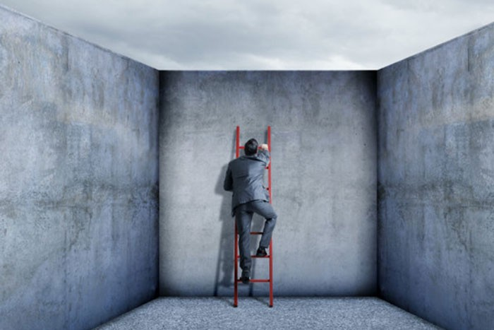
How do we respond when we
Feel stuck in difficult situations?
Suffer inexplicable and painful loss?
Are harmed by those around us?

Slide 29
What about Us?
Have our Lives Been Transformed by the Gospel?
Are we truly content in difficult circumstances beyond our control?
Do our vision and passion for God’s purposes fade in difficulty?

Slide 30
What are God’s Purposes for Us?
But you are a chosen people, a royal priesthood, a holy nation, a people belonging to God, that you may declare the praises of him who called you out of darkness into his wonderful light.
1 Peter 2:9

Slide 31
What about Us?
Have our Lives Been Transformed by the Gospel?
Are we truly content in difficult circumstances beyond our control?
Do our vision and passion for God’s purposes fade in difficulty?
Do we live in expectant faith that God is at work?

Slide 32
What is God asking us to trust him for?
Do we recognize it when we see his work?

Slide 33
What about Us?
Have our Lives Been Transformed by the Gospel?
Are we truly content in difficult circumstances beyond our control?
Do our vision and passion for God’s purposes fade in difficulty?
Do we live in expectant faith that God is at work?
Do we live lives of joy?

Slide 34
Would people around you describe you as a joyful person?

Slide 35
How can we Summarize this?
The goal of gospel transformation is for Jesus and his purposes to become #1 in our lives!

Slide 36
Jesus and his Purposes…
Are we truly content in difficult circumstances beyond our control?
Do our vision and passion for God’s purposes fade in difficulty?
Do we live in expectant faith that God is at work?
Do we live lives of joy?

Slide 37
How do we get there???
Are we truly content in difficult circumstances beyond our control?
Do our vision and passion for God’s purposes fade in difficulty?
Do we live in expectant faith that God is at work?
Do we live lives of joy?

Slide 38
The place to start is by responding as God wants us to respond in the situation we are in today!
Are we truly content in difficult circumstances beyond our control?
Do our vision and passion for God’s purposes fade in difficulty?
Do we live in expectant faith that God is at work?
Do we live lives of joy?

Slide 40
NT Preaching link at BibleStudyDownloads.org
Get this presentation for free!
Notes:
NT Preaching (np)

